Slide 1
LLM-Guided Reminiscence Therapy System

Slide 2
Overview of Mental Health Challenges
Problem
Lack of personalization: Traditional therapy methods often fail to address individual emotional states and personal histories.
Limited adaptability: Conventional approaches struggle to adjust to the user's evolving needs during therapy.
Solution
Advanced technology: Combines knowledge graphs and large language models (LLMs) to map user inputs to clinical concepts and generate personalized therapeutic responses.
Multiple therapeutic techniques: Integrates approaches like Cognitive Behavioral Therapy (CBT) and Psychodynamic Therapy to meet diverse user needs.
Emotional adaptability: Dynamically adjusts therapeutic strategies based on the user's detected emotions for a more engaging and effective experience.

Slide 3
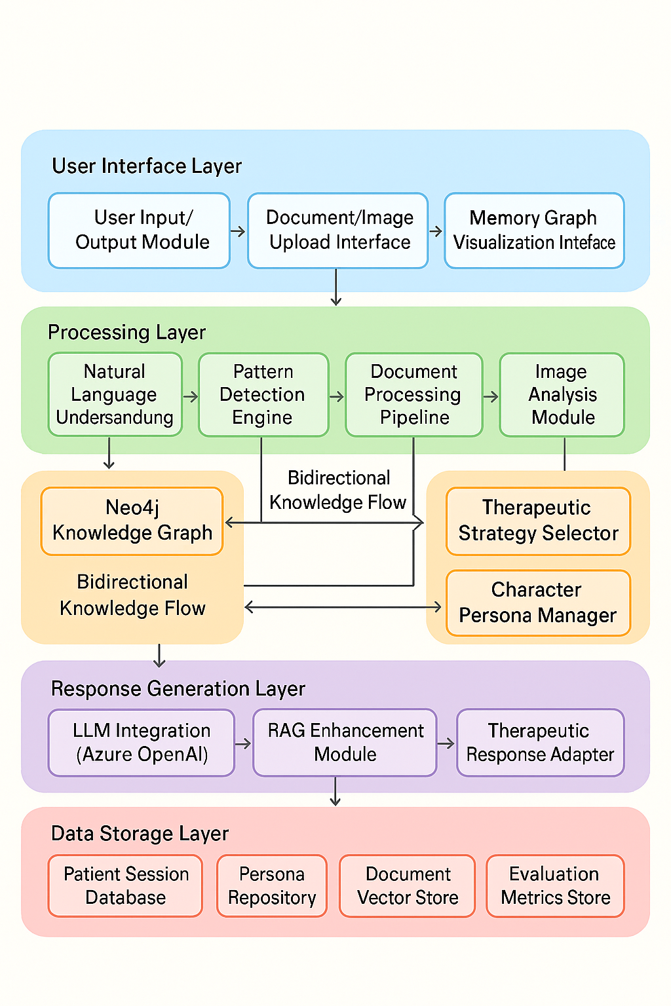
System Architecture:
Features a five-layer design: user interface, processing, knowledge and reasoning, response generation, and data storage.Supports multi-modal inputs like text, documents, and images for a rich user experience.Relies on a Neo4j-based knowledge graph as the core for clinical knowledge and reasoning.

Slide 4
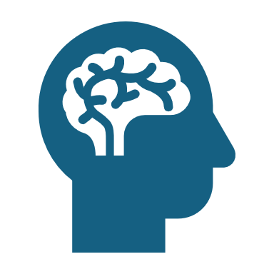
Dataset
Depression and Anxiety Dataset
Contains clinical features relevant to mental health assessment, specifically focused on depression and anxiety.
Includes:
Patient Health Questionnaire-9 (PHQ-9) scores for assessing depression severity.
Generalized Anxiety Disorder-7 (GAD-7) scores for evaluating anxiety severity.
Comprehensive demographic information (e.g., age, gender, etc.).
Treatment status indicators (e.g., whether the patient is undergoing treatment).
Standardized disorder classifications (e.g., diagnostic categories for depression and anxiety).

Slide 5
. Mental Illness Dataset
Content: Provides a broader range of clinical features related to various mental health conditions, not limited to depression and anxiety.
Includes:
Patient Health Questionnaire-9 (PHQ-9) scores for depression assessment.
Generalized Anxiety Disorder-7 (GAD-7) scores for anxiety assessment.
Comprehensive demographic information.
Treatment status indicators.
Standardized disorder classifications covering a wide spectrum of psychiatric conditions, such as mood disorders, obsessive-compulsive disorders, eating disorders, substance use disorders, neurodevelopmental disorders, personality disorders, and psychotic disorders.

Slide 6
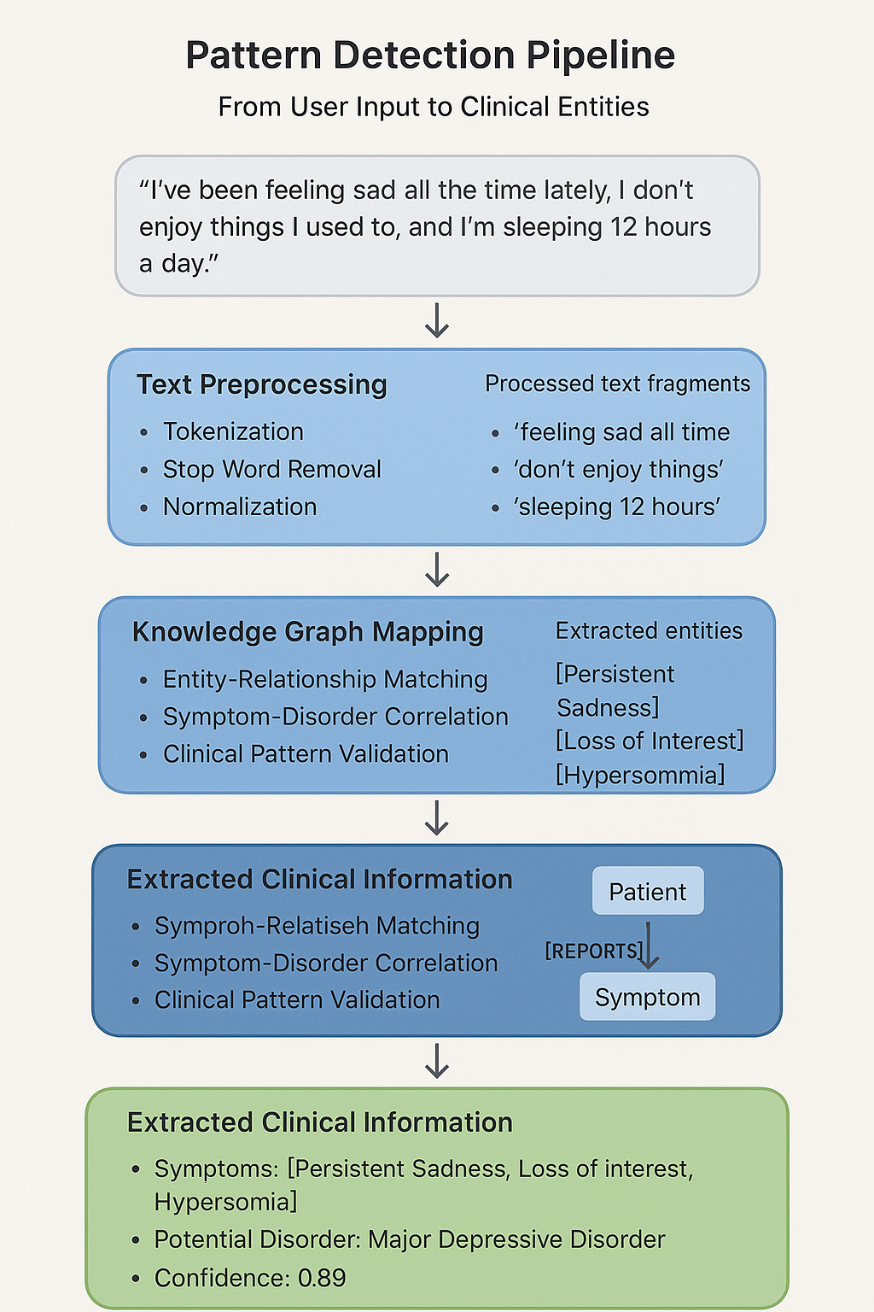
Pattern Detection pipeline
Knowledge Graph:
Models mental health entities such as disorders, symptoms, behaviors, patients, and therapies.
Defines relationships between nodes to enable advanced, personalized inference.
Pattern Detection and Clinical Entity Mapping:
Uses a natural language understanding pipeline to process user messages.
Extracts symptoms, behaviors, and temporal patterns through preprocessing, clinical entity extraction, and knowledge graph mapping.
Validates clinical patterns to ensure accurate therapeutic insights.
Emotion Detection:
Employs a transformer-based model, fine-tuned on emotional expression datasets.
Identifies primary emotions and their intensities to guide therapeutic strategies.

Slide 7
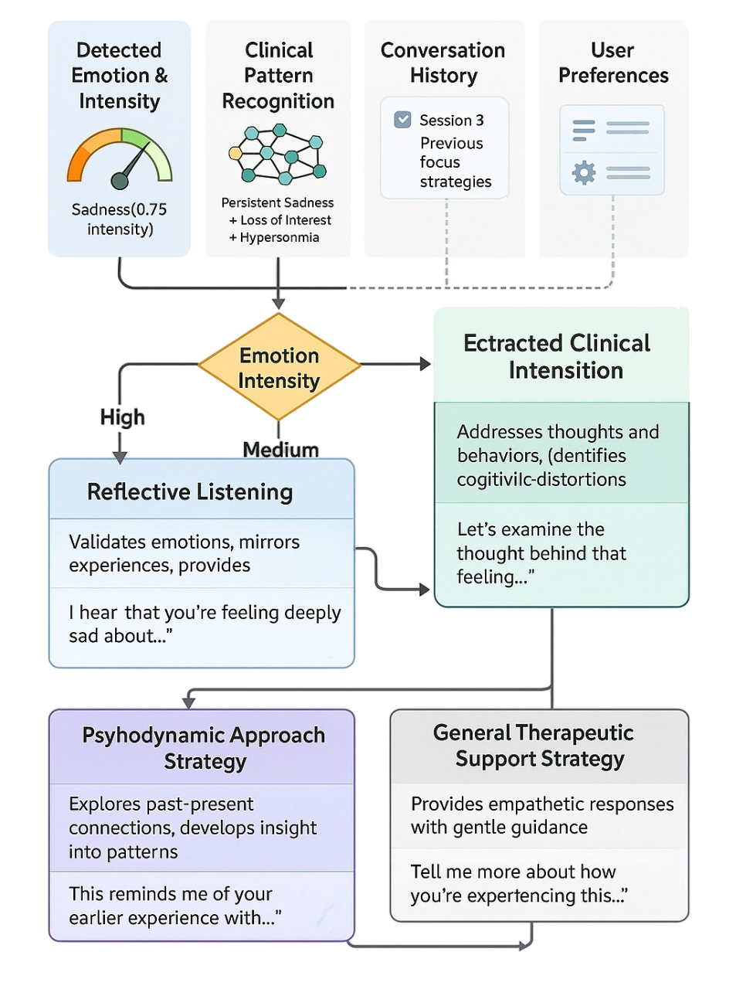
Therapeutic Response Generation:
Selects strategies using a context-aware mechanism based on emotional state, clinical patterns, and conversation history.
Generates personalized, evidence-based responses via retrieval-augmented generation.
Character-Based Role-Playing:
Adapts therapeutic responses to match specific character personas for better engagement.
Balances relatability with clinical effectiveness.
Memory Graph Visualization:
Creates an interactive network representation of extracted memories and their relationships.
Supports therapeutic exploration by visualizing connections and patterns.

Slide 8
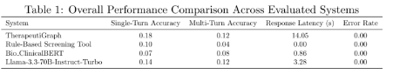
results
Systems ComparedSummary:
TherapeuticGraph (Neo4j-based, knowledge graph with relationship-based reasoning) was evaluated against:Rule-Based Screening Tool: Uses keyword matching and scoring, fast but lacks contextual understanding.Bio_Clinical BERT: Transformer-based, pre-trained on biomedical texts, specialized for clinical text understanding.Llama-3.3-70B-Instruct-Turbo: 70-billion-parameter general-purpose LLM, accessed via Together.ai, without mental health-specific training.

Slide 9
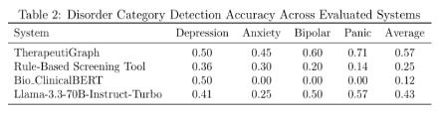
Disorder-Specific Detection Performance
TherapeuticGraph excelled in detecting specific disorders, particularly those with complex symptom profiles and comorbidities.
Strong performance in panic disorder (71%) and bipolar disorder (60%).

Slide 10
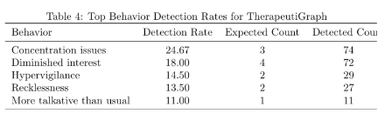
Symptom and Behavior Detection Analysis
TherapeuticGraph
demonstrated high sensitivity in detecting symptoms and behaviors across multiple conversation turns, enabling longitudinal pattern recognition.Showed a tendency toward over-detection, capturing subtle indicators but potentially increasing false positives.

Slide 11
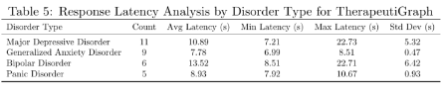
Response Latency Analysis
TherapeuticGraph
exhibited higher response latency due to complex graph-based reasoning, particularly for disorders with extensive symptom profiles.Generalized Anxiety Disorder showed consistent processing times, while Major Depressive Disorder and Bipolar Disorder required longer due to complex evaluations.

Slide 12
Conclusion
The "LLM-Guided Reminiscence Therapy System" introduces TherapeuticGraph, a novel system integrating large language models with a Neo4j-based knowledge graph to deliver personalized, multimodal mental health support. Achieving a 57% average diagnostic accuracy, it outperformed rule-based tools (25%), Bio_Clinical BERT (12%), and Llama-3.3-70B (43%), excelling in complex disorders like panic (71%) and bipolar (60%). Its high sensitivity in symptom and behavior detection, robust multi-turn reasoning, and interactive memory graph visualization enhance therapeutic engagement and continuity. Despite higher latency due to graph-based reasoning, the system’s clinical accuracy and personalization justify the trade-off. By combining evidence-based strategies, character-based role-playing, and ethical considerations, TherapeuticGraph advances mental health AI, offering a scalable, complementary tool for therapists, with potential for further refinement to reduce over-detection and optimize performance.

